Slide 1
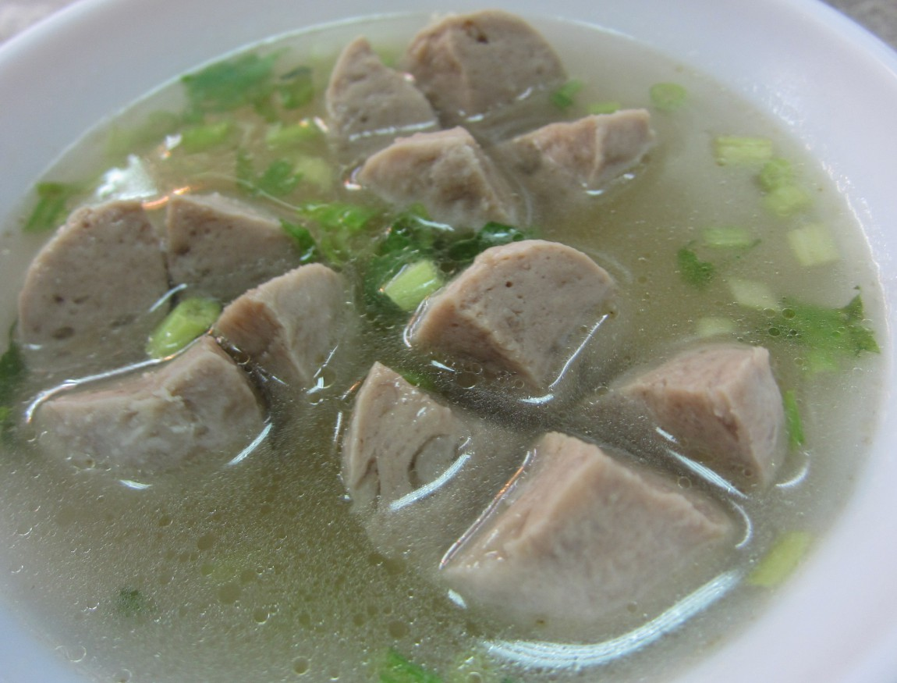





Taiwan Xiao-Chi
Differ between Northern and Southern Xiao-Chi
Northern Xiao-Chi
Southern Xiao-Chi
Shopping List
Kong Oan
Kong Oan, also known as bouncy meatballs, are typical Taiwanese street food items. These Taiwanese meatballs usually consist of highly seasoned, ground fatty pork mixture combined with chopped shiitake mushrooms, tapioca starch, baking powder, and egg whites.
Is Kong Oan suitable to make at home? : NO
Unfortunately, Kong Oan could not be made in our kitchen, because Kong Oan is made by several complicated processes. However, we could easily buy Kong Oan in Asian supermarket.
The soup at the left side is Kong Oan soup, which is also a common and popular Xiao-Chi in Taiwan.
Its recipe is very easy. Boil a pot of water, put Kong Oans into it , cook until Kong Oans are heat (supermarket usually sell cooled Kong Oans, we only need to heat it). Put any season you like into it, then the Kong Oan soup is done
Taiwan Xiao-Chi
Northern Xiao-Chi
Southern Xiao-Chi
Differ Between northern and Southern Xiao-Chi
Shopping List

